Slide 1
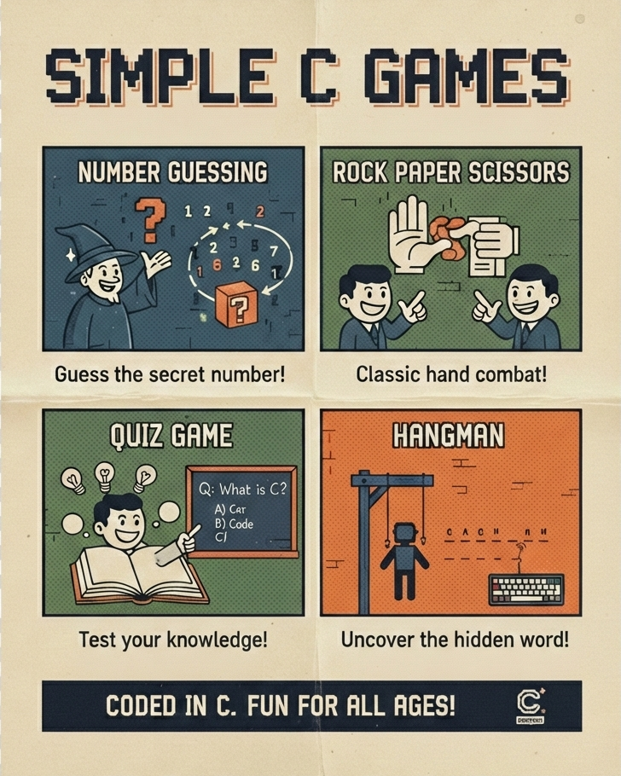
Game-Based Learning Using C Programming
A Menu-Driven Game Hub
Course: FOP / C Programming
Semester: 2
Team Members:
Manikanth Kulkarni : 1262250774 Shubhan Patnala : 1262251314
Aryan Panigrahi : 1262251088
Agastya Dumbre : 1262254028
Shaurya Thapa : 1262252690
Faculty: Nikhil Soniminde University: MIT WPU

Slide 2


C: Ideal for Logic-Driven Applications
Demonstrating Core C Concepts
The C programming language, with its robust structure and direct hardware access, is exceptionally well-suited for developing logic-based applications. Its efficiency and control make it a powerful tool for crafting the core mechanics of games, where precise logic and performance are paramount.
This project serves as a practical showcase for fundamental C programming concepts; all wrapped within an entertaining game environment. From basic data types and control structures to more advanced topics like functions and arrays, each game is designed to illustrate these principles in action.

Slide 3
Project Overview:
Our project delivers a comprehensive, menu-driven application designed to make learning C programming concepts both fun and engaging. This hub features a collection of interactive games, each showcasing different programming techniques.
Menu-Driven Application
Four Interactive Games
Score Tracking System
Color-Formatted Output
Easy navigation through a central menu.
Diverse games covering various C concepts.
Persistently tracks scores across all games.
Enhanced readability with ANSI escape codes.
Games Included:
Number Guessing Game
Quiz Game
Hangman Game
Rock Paper Scissors

Slide 4






Program Flow: Navigating the Game Hub
The application's logical structure ensures a smooth and intuitive user experience. From game selection to score management, each step is carefully orchestrated.
Select Game
Update Score
Replay or Menu
Main Menu
Run Game
This sequential flow provides clarity for users. This design allows for easy expansion with new games and features.

Slide 5
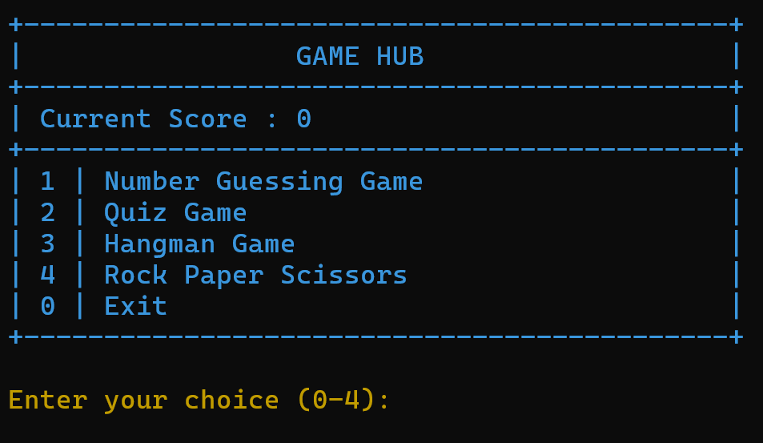
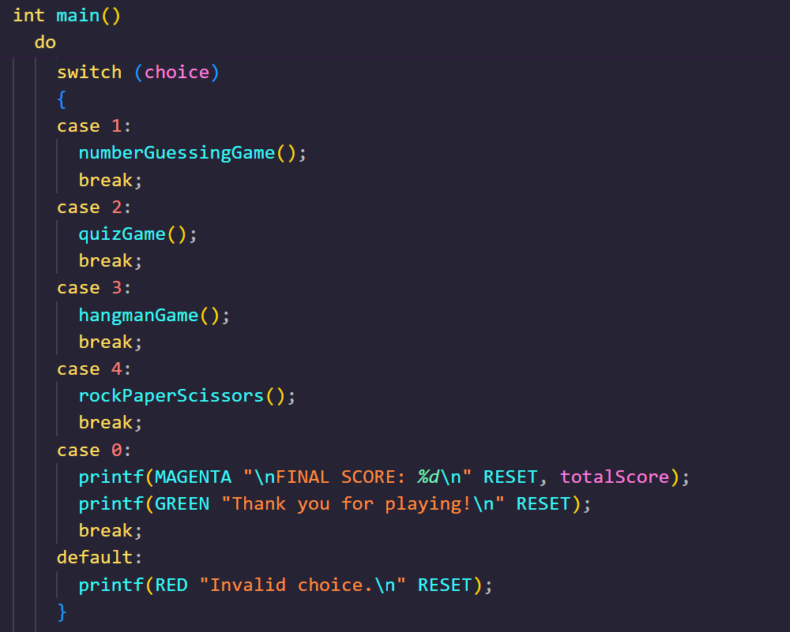
Main Menu Design:
The main menu operates within a do-while loop, ensuring continuous access until the user explicitly chooses to exit.
Game selection is efficiently handled using a switch-case structure, directing the user to their chosen game.
Robust input validation is implemented to prevent unexpected program crashes from invalid menu choices.
ANSI colours are applied throughout the menu, significantly enhancing readability and user engagement.

Slide 6
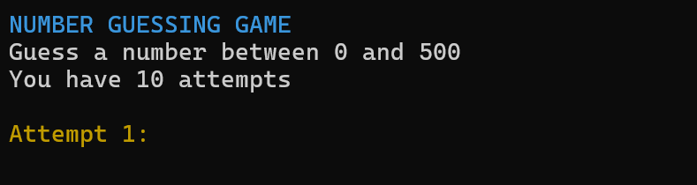
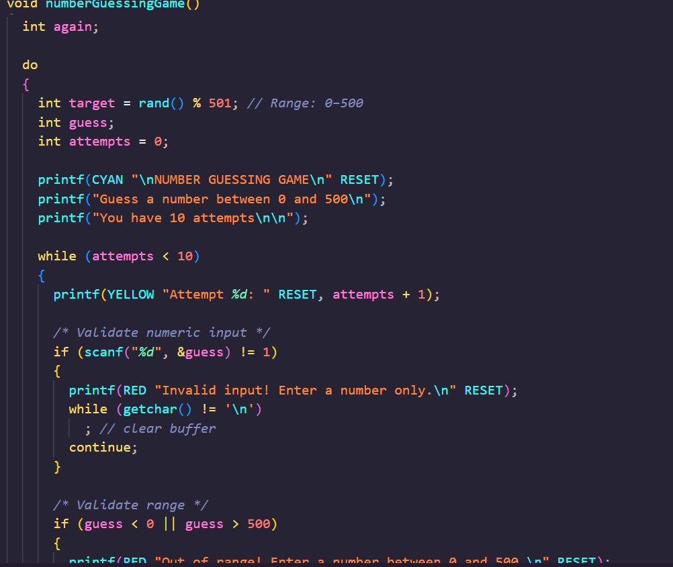
Number Guessing Game
Gameplay Mechanics
The computer generates a random number between 0 and 500.
Players are granted 10 attempts to guess the correct number.
Helpful "higher/lower" hints are provided after each guess.
Invalid inputs (e.g., letters instead of numbers) are rejected.
A score is awarded upon successful completion of the game.
C Concepts Used:
Random Numbers (rand())
Conditionals (if-else)
Loops (for/while)
Input Validation

Slide 7
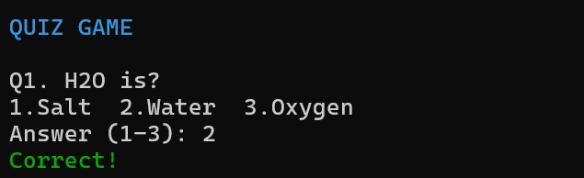





Quiz Game
How It Works:
Features a comprehensive question bank of approximately 100 questions.
Questions are selected randomly for each game, ensuring no repetition.
All questions are presented in a multiple-choice format.
Input validation restricts answers to options 1-3 only.
Correct answers increase the player's overall score.
C Concepts Used:
Arrays
Random Selection
Logical Conditions
Score Handling

Slide 8
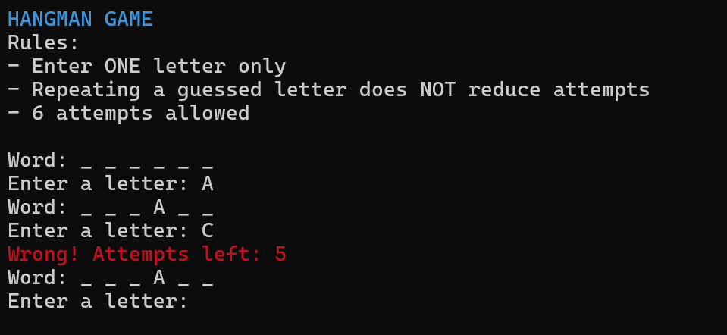




Hangman's Challenge
Gameplay Dynamics
A random word is chosen from a diverse word bank.
Players guess one letter at a time to uncover the word.
Repeated correct letters do not penalise attempts.
Players are allowed a maximum of 6 incorrect guesses.
The hidden word is gradually revealed with each correct guess.
C Concepts Used:
Strings
Character Handling
toupper() & isalpha()
String Comparison

Slide 9
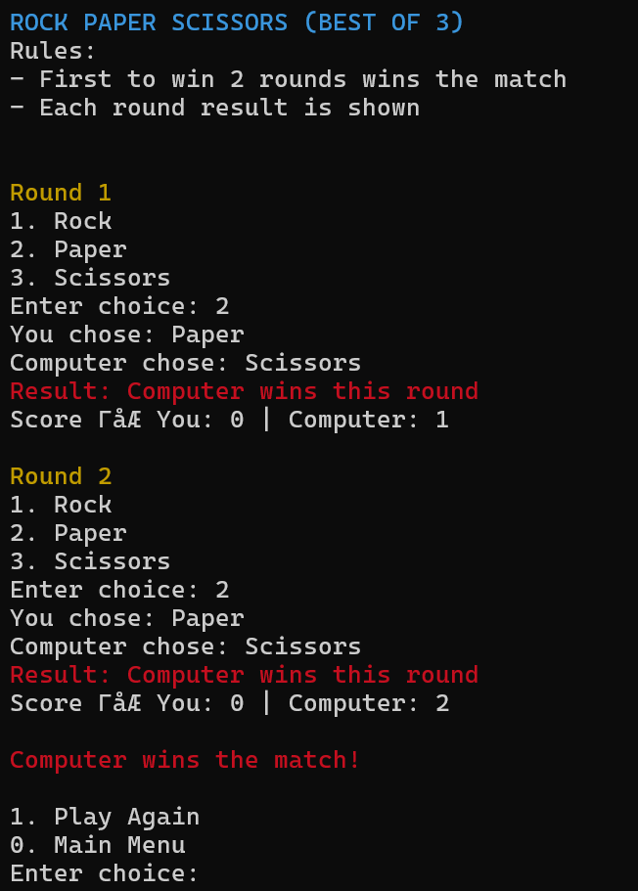
Rock Paper Scissors
Implemented Game Rules
Each match is played as a best-of-three series.
Every round clearly indicates the winner or if it's a tie.
The first player to win two rounds secures the match victory.
The player's score is updated only after winning a full match.
C Concepts Used:
Nested Loops
Conditional Logic
Random Computer Choice

Slide 10
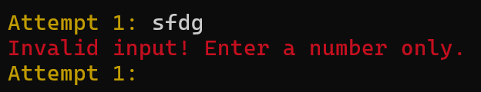
Input Validation & Error Handling
Preventing Invalid Input
Mitigating Buffer Issues
Ensures that users cannot enter characters where numerical input is expected, preventing data type mismatches.
Incorporates techniques like getchar() to clear the input buffer, averting common problems with subsequent inputs.
Ensuring Valid Choices
Crash Prevention
Guarantees that menu selections and game options are within permissible ranges, enhancing user experience.
These measures collectively safeguard the program from crashing due to erroneous or malicious user input.
Effective input validation, often involving checking scanf return values, is critical for creating stable and user-friendly C applications.

Slide 11

Robust Score Tracking System
Our project incorporates a comprehensive score tracking system, designed to reward players for their successes across various games. This feature adds a competitive element and allows users to monitor their progress.
Global Score Variable
Dynamic Score Updates
Final Score Display
A central, global variable efficiently manages and stores the player's cumulative score throughout their gaming session.
The score is automatically updated after each game, reflecting the player's performance and contributing to their overall total.
Upon exiting the application, the player's final accumulated score is prominently displayed, providing a clear summary of their achievements.

Slide 12
Game-Specific Score Contributions
Each game within the console application contributes to the overall score based on its complexity and challenge, providing a fair points system.
1
2
Guessing Game
Quiz Challenge
Successfully completing the Guessing Game awards a bonus of 10 points.
Players earn 5 points for every correct answer in the Quiz game, encouraging knowledge and accuracy.
3
4
Hangman Mastery
Rock Paper Scissors
Conquering the Hangman game yields a substantial 15 points, reflecting its higher difficulty.
Winning a Rock Paper Scissors match adds 10 points to the total score, celebrating strategic thinking.

Slide 13
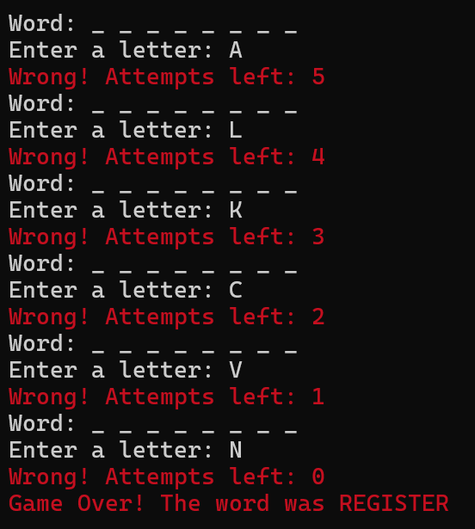
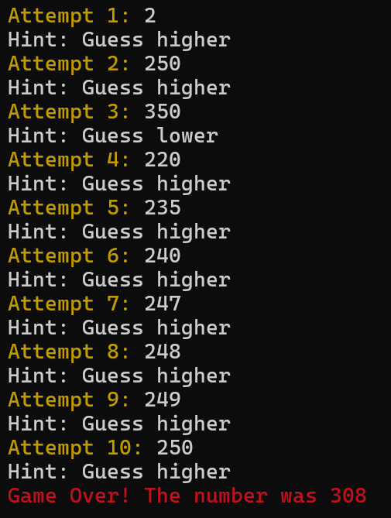
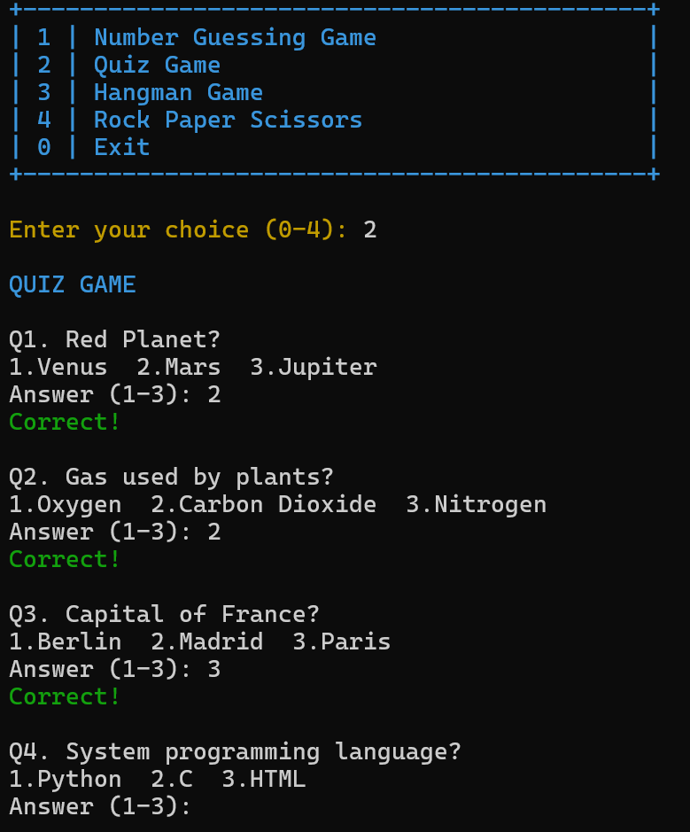
Elevating User Experience with ANSI Color Formatting
To enhance clarity and visual appeal, our console application leverages ANSI escape codes for dynamic color formatting.
Utilising ANSI Escape Codes
These special character sequences control text attributes like colour and style directly within the console output, making the interface more engaging.
Improved User Experience
By adding colour, we make output easier to read and differentiate, reducing cognitive load and making the application more pleasant to use.

Slide 14

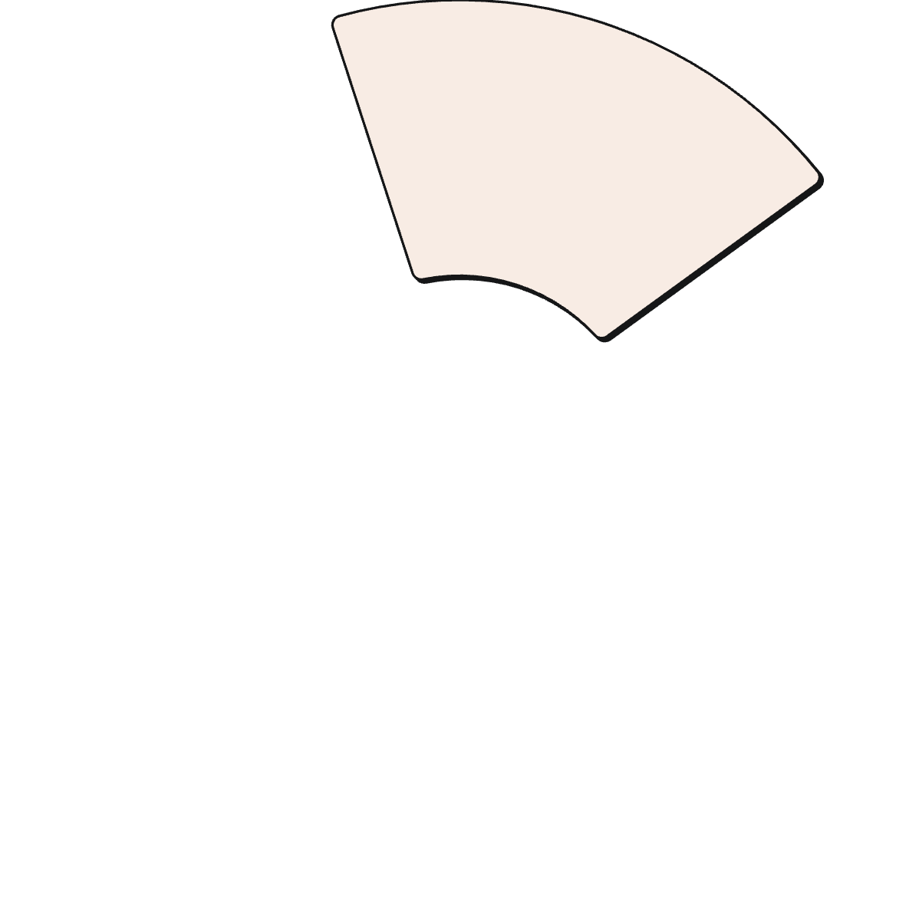








Future Enhancements & Opportunities
The current console-based game suite serves as a strong foundation, with numerous avenues for future development and expansion.
File-Based Score Saving
Difficulty Levels
Persistently store high scores, allowing users to track progress across multiple sessions.
Introduce varied challenges to cater to different skill levels, increasing replay value.
Timer-Based Quiz
Add a time constraint to the quiz, increasing pressure and testing quick recall.
GUI Version
Migrate the console games to a graphical user interface for a more modern and visually appealing experience.
Multiplayer Mode
Implement options for two players to compete, adding a social and competitive dimension.

Slide 15

Learning Outcomes
Logical Thinking
Handling User Input
Problem Solving
Structured Programming

Slide 16

We appreciate your attention.

